Slide 1
Workflow Optimisation Project

Slide 2
Introduction
LLMs is an opportunity to improve productivity.
Productivity requires new workflows.
Private enterprise data is the difference in the market.
Make sense to focus on workflows related to private data.
Notes:
Large Language Models allow to replace mundane text generation with automation. This can lead to reduction in labour expenses and increase in profitability.
Incorporating LLMs require changes in business process.
Every company have access to LLMs trained on public data. Therefore, the knowledge of public data is not a competitive advantage. Only private data gives advantage.
Investing in LLM workflows should focus on using private data. This gives biggest advantage.
More context – what we try to automate. – context of security work

Slide 3
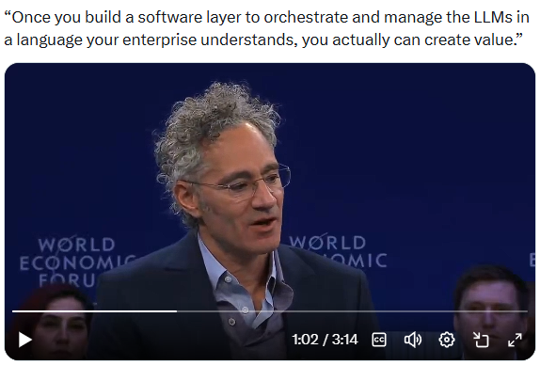
Relevant Quote
Notes:
Large Language Models allow to replace mundane text generation with automation. This can lead to reduction in labour expenses and increase in profitability.
Incorporating LLMs require changes in business process.
Every company have access to LLMs trained on public data. Therefore, the knowledge of public data is not a competitive advantage. Only private data gives advantage.
Investing in LLM workflows should focus on using private data. This gives biggest advantage.
More context – what we try to automate. – context of security work

Slide 4
Example Case
Proof of Concept use private and public data.
Private data – collection of documents
Public data – general data used for training LLM
Notes:
In the example application we combine private and public data.
Private data is collected from penetration test reports conducted on the enterprise network and applications. Results recorded in the reports are confidential to the organisation.
Public data is the PCI DSS standard. This standard is a part of public domain. As a result, generally available LLMs are trained on this document.

Slide 5
Technologies of Machine Learning
Machine learning in enterprise settings should focus on private data.
There are two major ways to implement ML:
RAG
LLM Tuning
Notes:
When the company decides to use LLM in business, it should decide how to incorporate private data in the machine.
We will briefly describe the methods to deliver private data in the machine.

Slide 6
Retrieval-Augmented Generation
RAG advantages
Data manipulation portable between LLM providers.
Initial step for LLM tuning
Conversion of documents to structured data
RAG disadvantages
Low performance
Low precision
Notes:
RAG keeps private data separate from the machine in the database.
Such database has to be created and maintained by the organisation.
Part of the example application called Indexer creates and maintains RAG database.
Note that the steps required to created RAG solution can be reused in Tuning solution.

Slide 7
LLM Tuning
Tuning advantages
High performance
High precision
Tuning disadvantages
Tuning expense
Periodic re-tuning required
Notes:
Tuning process incorporates private data into LLM decision making.
This method depends on the quality of data supplied.
Note that RAG solution can be used to verify quality of data before deployment of Tuning solution.

Slide 8
Summary: RAG as an Entry Point
RAG solution as an entry to LLM workflows
RAG allows to convert unstructured data to structured
RAG allows to implement effective authorisation mechanism
RAG allows to verify quality of data
Notes:
We believe that organisations entering ML can benefit from gradual introduction.
RAG allows to introduce ML at a cost lower that Tuning.

Slide 9
Pydantic Agent
Agentic AI Library
Supports OpenAI, Google, Ollama and others
Strong types based on JSON schema
Wraps iterative LLM calls
Serves as the foundation of many LLM SDKs
Notes:
We use Pydantic development library to create our ML applications.
We believe that Pydantic provides the balance of features and portability across major ML platforms.
Investing in Pydantic Agent solution reduces the risk of obsolete technology.

Slide 10
Architecture Summary
Example app is a hybrid architecture
Cloud-based LLM accessed via REST API
Local vector database
Dual use web apps and command line scripts
Notes:
Our example application stores RAG database separately from Cloud LLM.
This allows full control of private data.
We can use the apps with Web interface
Or we can run apps as service scripts

Slide 11
Source Code
Public repository on GitHub
github.com/DarlowieTechnology/a_bridge_too_far
Python, Pydantic, Django, ChromaDB
4 applications (generator, indexer, query, discovery)

Slide 12
Hardware Platform

Slide 13
MINISFORUM MS-S1 Max
AMD Ryzen™ AI Max+ 395 Platform
CPU: Ryzen AI Max 300, 3.00 GHz, 16 / 32 cores
GPU: Radeon 8060S 2 GB with additional 96 GB RAM
16 GB general use RAM
16 GB shared RAM (GPU and NPU)
Notes:
Default memory configuration of MS-S1 Max is a 64 GB general memory and 64GB of shared memory for OS, GPU, NPU.
AMD Variable Graphics Memory (VGM) is a preallocated continuous block of physical memory.
Enabling VGM improves MLPerf score 2-3% compared with default configuration.
Total potential memory for GPU is 112 GB (96 + 16).

Slide 14
Baseline: Dell Precision 7530
General-purpose Intel-based workstation
CPU: Intel i7-9750H, 2.60 GHz, 6 / 12 cores
GPU: NVidia Quadro T1000 4 GB
64 GB general RAM
35.9 GB shared RAM (GPU)
Notes:
Baseline for MLPerf performance comparison.
This workstation was released in 2018.
Note that the current Dell Precision 7680 costs AUD 4700 which is comparable in price to Minisforum MS-S1 Max (AUD 4300)
Memory is shared between CPU and GPU via NVidia driver.

Slide 15
Benchmarks
MLPerf Client v1.5 on Windows 11 Pro
Llama 3.1 8B Instruct
Phi 3.5 Mini Instruct
Notes:
MLPerf is a self-contained benchmark.
MLPerf uses small LLMs to allow better coverage across platforms.
MLPerf results are indicative of platform performance.
Business-specific workloads may have different results.

Slide 16
MLPerf Results
Benchmark | Dell Precision 7530 | Minisforum MS-S1 Max
Llama 3.1 8B Instruct
Time to First Token | 38.99 | 1.21 (3222% better)
Tokens per Second | 3.4 | 37.5 (1102% better)
Phi 3.5 Mini Instruct
Time to First Token | 19.02 | 2.09 (910% better)
Tokens per Second | 25 | 25.4 (2% worse)
Notes:
Llama 3.1 8B results show significant improvement.
Phi 3.5 Mini results show improvement in start up.

Slide 17
LLM Host Evaluation

Slide 18
LLM Host Comparison on MS-S1 Max
Host Name | Local /Cloud | Usage Restrictions | Access to Models | GPU Support | Performance on test data
Ollama | Local | No | Limited by hardware | No support for AMD Radeon 8060S | 40 sec
LM Studio | Local | No | Limited by hardware | Yes | 10 sec
Google | Cloud | Yes | Unlimited | N/A | 4 sec
Notes:
gpt-oss-20b LLM was used on local hosts. Gemini 3.1 was used on Google clous.
Usage restructions on Google Cloud force users into paid-for solution.
Ollama uses PyTourch and AMD ROCm drivers to implement GPU acceleration. PyTourch has to be compiled with CUDA support. Compilation would require GCC and Clang support. Conclusion: doable but not production level.
In contrast to Ollama, LM Studio supports AMD GPU acceleration out of the box on Windows. It is recommended by AMD.
Cloud provider outperform local host

Slide 19
LLM Evaluation

Slide 20
LLM Evaluated
Host | Provider | Name | Performance on test data
LM Studio local | OpenAI | gpt-oss-120B | 9.9 sec
LM Studio local | OpenAI | gpt-oss-20B | 9.6 sec
LM Studio local | Meta | Llama 3.3 | 18.5 sec
Ollama cloud | OpenAI | gpt-oss-120B | 7.7 sec
Ollama cloud | Google | Gemini 3 Flash | 22.9 sec
Google cloud | Google | Gemini 3.1 | 3.6 sec
Notes:
Local hosting provided by LM Studio
Cloud hosting provided by Ollama Cloud and Google Cloud
Cloud models outperformed local host
All locally hosted models had same parameters:
Temperature: 0.1
Seed: 1
Reasoning effort: Low
Gemini had default parameters.

Slide 21
Discovery Evaluation

Slide 22
Discovery App Dataset
Action | Dell Precision 7530 Ollama host gpt-oss-120B cloud nomic-embed-text | MS-S1 Max LM Studio host gpt-oss-120B local nomic-embed-text
Raw file load | 91.43 sec
Chunking | 0.57 sec
Notes:
Dataset consist of:
20 LLM research papers in PDF
11 penetration test reports in PDF
20 medical research notes in plain text
20 engineering Q/A in JSON

Slide 23
Indexer Application

Slide 24
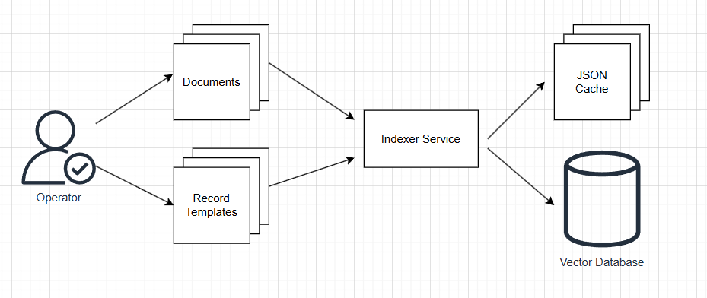
High-Level Indexer Service Design
Notes:
Operator extracts private data from unstructured documents
Operator monitors quality of data
Operator is a privileged role with access to all the data.

Slide 25
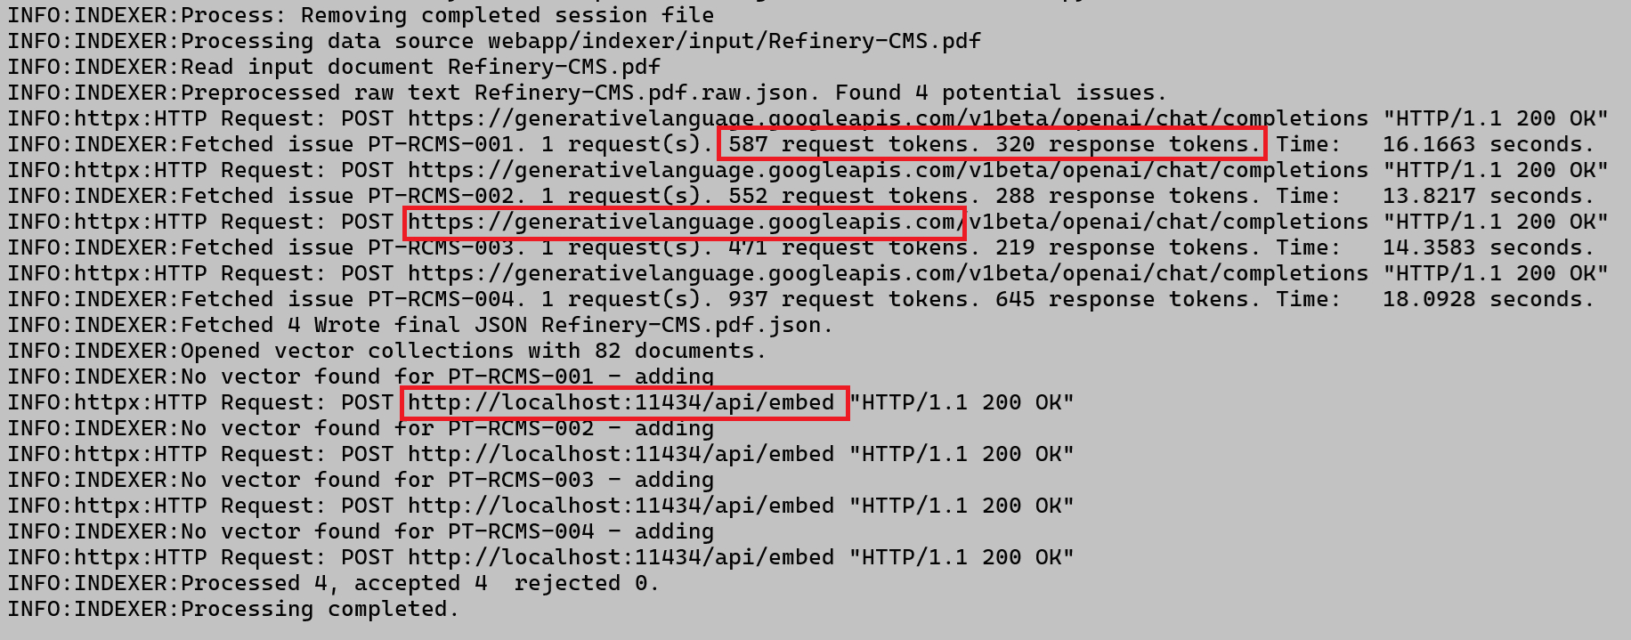
Indexer Output
Notes:
Dual use Indexer app executed as command line script
Calls to Cloud deployed Gemini LLM consume tokens
Call to local RAG database do not consume tokens

Slide 26
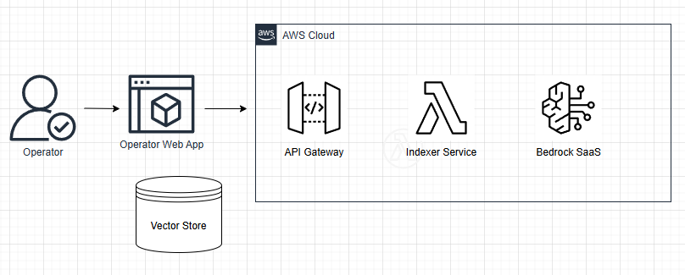
Hybrid Architecture
Notes:
Hybrid architecture allows flexibility
Where the database is stored
Where the application itself is deployed
What LLM host service is used
All of these components can be configured to minimise operational expenses

Slide 27
Query Application

Slide 28
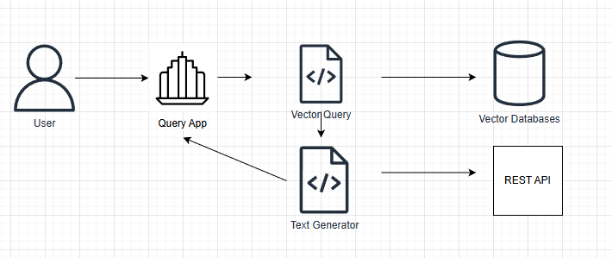
High-Level Query App Design
Notes:
Query application uses RAG database and cloud deployed LLM
Cloud access via REST API specific to the LLM provider
Answer is generated in two steps
1. RAG database query to select private data set
2. Combine initial query with RAG data in the final LLM query.

Slide 29
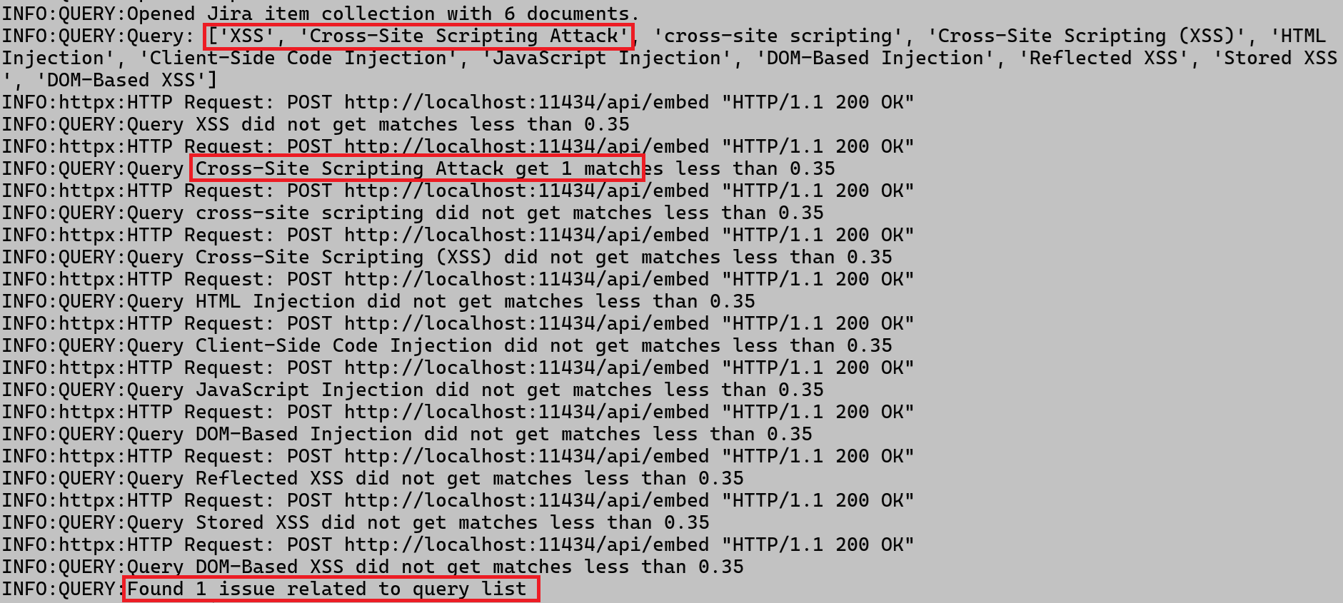
Query RAG Query
Notes:
Original query is XSS
RAG database is queried for list of synonyms
Returns from RAG queries create context for the final call to general LLM

Slide 30
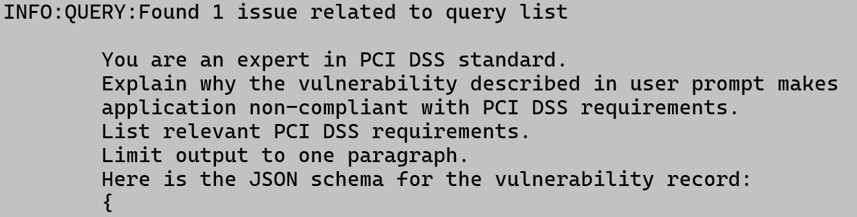
Query Final Query
Notes:
Final query to general LLM asks about PCI DSS
RAG query result is incorporated as a structured input

Slide 31
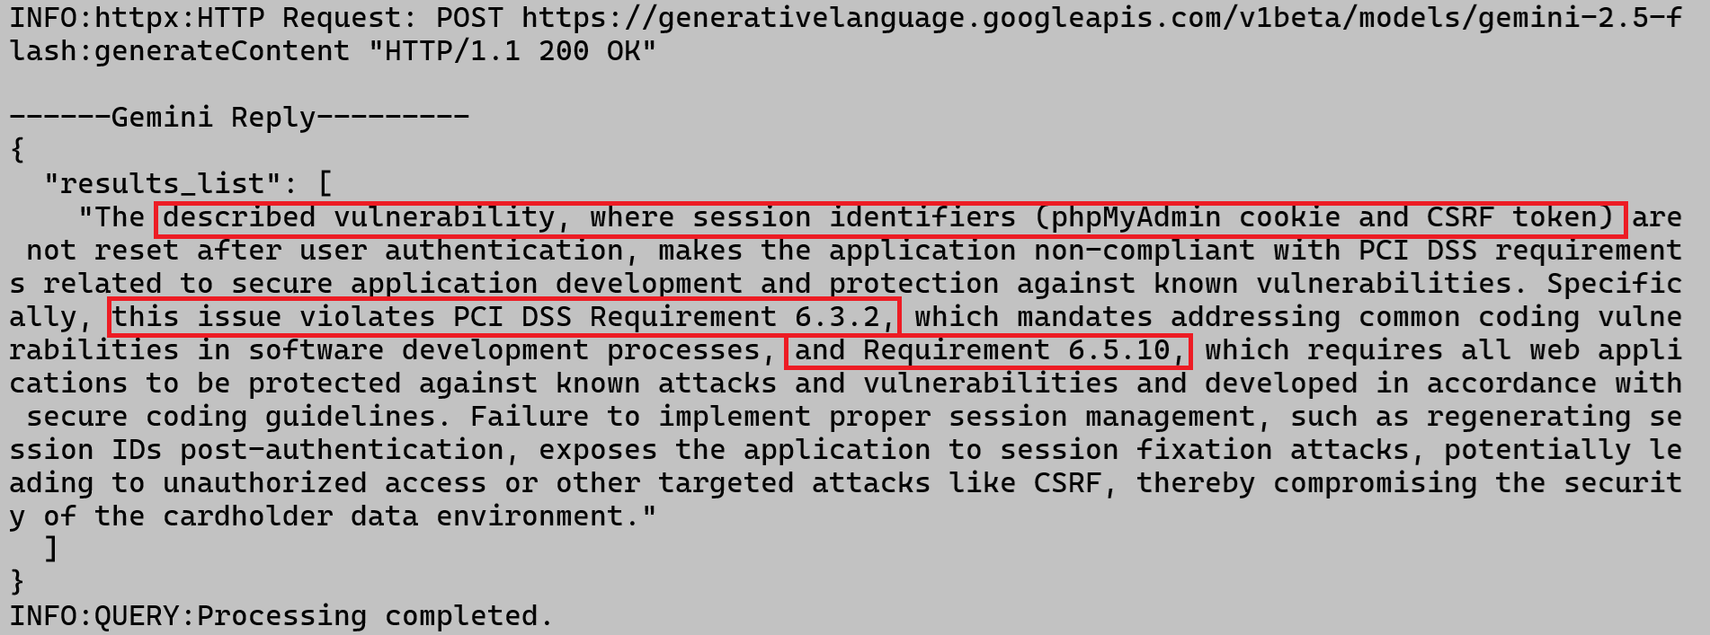
Query Final Query
Notes:
The reply from general LLM incorporates:
- private data
- public data in the form of PCI DSS

Slide 32
Query Semantic Search
Query “XSS issues”
Semantic search returns:
The installed version of Jenkins server was affected by a number of security vulnerabilities. Known vulnerabilities included CSRF and XSS weaknesses.
Notes:
An example of semantic search results that illustrate the challenge of data retrieval:
- The intent of the query was to retrieve all issues describing XSS vulnerabilities in the software.
- The item retrieved by semantic search described potential XSS vulnerability in a third-party application “Jenkins”.
- From the point of view of LLM, the answer matches the query. There is an XSS issue in Jenkins. Job well done.
- From the point of view of the user, this answer is likely incorrect. The information about third-party XSS issue is not relevant to enterprise software developer.

